Slide 1
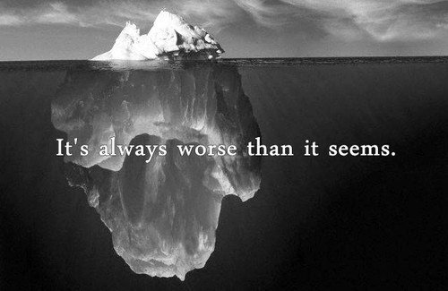
Depression
By: Kathryn Baker, Sara Gardiner,
Amanda Hudson, Sascha Peddle and Andrea Rose

Slide 2
Overview
What is depression?
Adolescent Depression
Sadness vs. Depression
Signs and Symptoms
-Physical Changes
-Changes in Thinking
-Changes in Feeling
-Changes in Behaviour
Etiology/Causes
Diagnosis
Treatments
Types of Depression
-Major Depression
-Atypical Depression
-Seasonal Affective Disorder
-Persistent Depressive Disorder
-Postpardum depression
Statistics
Suicide
Case Study
Implications for Teachers
Mindfulness
Resources

Slide 3
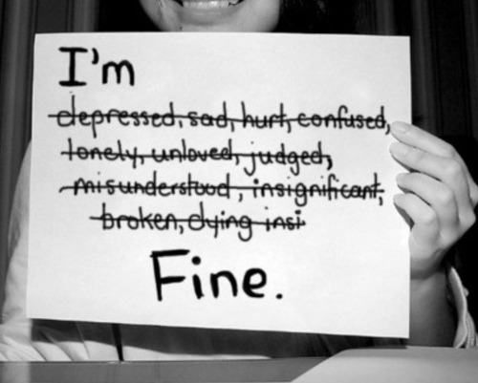
What is Depression?
Feelings of severe despair over an extended period of time
Serious debilitating illness that effects a person’s physical, emotional, behavioural and cognitive health
One of the most common mental health conditions affecting approximately 10% of the Canadian population

Slide 4
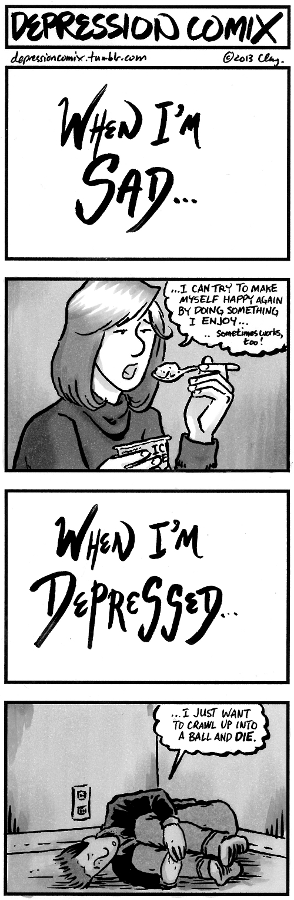
Sadness vs. Depression
Sadness lasts for short periods of time, Depression persists for weeks or months
Sadness usually does not impact a person’s ability to perform daily tasks or function productively whereas Depression does
Depression involves feelings of being hopeless,
helpless and worthless
Depression is an illness

Slide 5
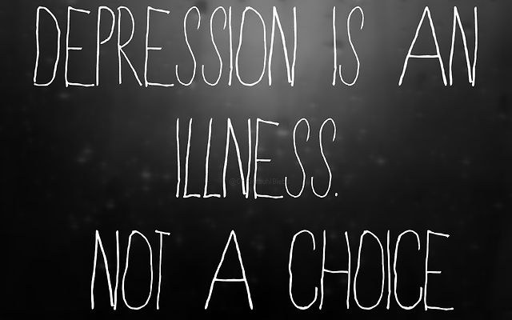
Adolescent Depression
Approximately 1 in 8 adolescents are affected by depression
Feelings of depression persist and interfere with ability to function
Is not a weakness or something that can be overcome with willpower
http://www.youtube.com/watch?v=MiS02j3zt68
http://sad-and-hungry.tumblr.com/

Slide 6
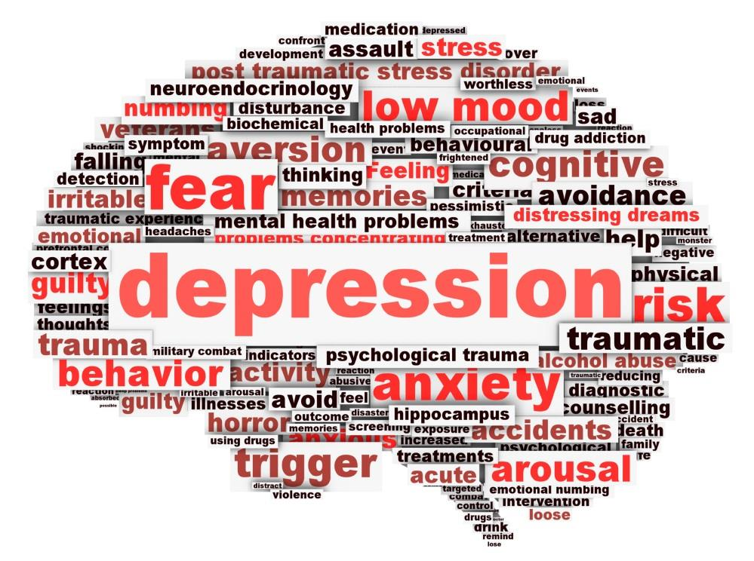
Signs and Symptoms
Some people experience multiple symptoms, others have just a few
Severity of symptoms are different for every person and vary over time
Changes in thinking, feeling, behaviour and physical wellbeing
If you are experiencing some of these symptoms, consult your physician to seek help
http://www.peterboroughfht.com/i-am-a-patient/program-and-services/mental-health-programs

Slide 7
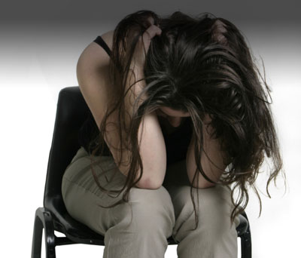
Physical Changes
Sleep disturbances (Insomnia or Hypersomnia)
Decreased energy, feelings of weakness and fatigue
Changes in appetite (Weight loss or gain)
Phantom pains, muscle aches, headaches
http://thistimethisspace.com/2007/05/13/headaches-be-gone-home-headache-remedy/

Slide 8
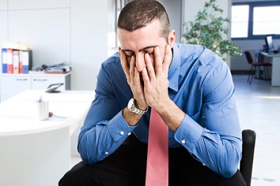
Changes in Thinking
Difficulty thinking, concentrating or remembering information
Trouble with making decisions
Preoccupation with failures and self-criticism
Persistent thoughts of self-harm, death or suicide
http://www.mentalhelp.net/poc/view_doc.php?type=doc&id=50442&cn=5

Slide 9
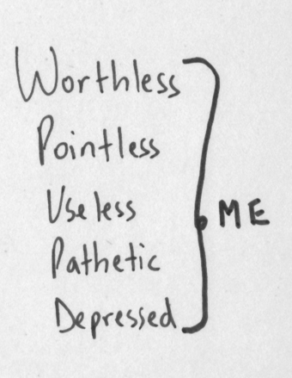
Changes in Feeling
Loss of interest in activities that were once enjoyable
Feelings of worthlessness, hopelessness
Decrease in and self-esteem and confidence
Feeling sad for an extended time period
Unexplained crying for no apparent reason
Irritability, impatience and aggressive feelings
http://rebloggy.com/post/black-and-white-text-depressed-depression-sad-words-pain-hurt-alone-ugly-worthle/41406828581

Slide 10
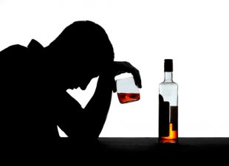
Changes in Behaviour
Withdrawal from social, work and leisure activities
Neglecting duties such as homework, chores and being irresponsible
Decrease in physical activity and exercise
Increased use of alcohol and drugs
Lack of self-care
http://www.alternet.org/drugs/link-between-alcohol-and-depression

Slide 11
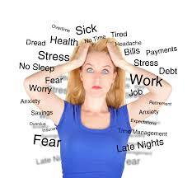
Etiology / Causes
Depression is not caused by one single factor.
Several factors which trigger depression include:
neurobiological factors (brain chemistry)
environmental factors (health, loss, stress at work)
genetic factors (family history)
psychosocial (isolation, bullying, family problems)
http://queryclub.com/?p=40

Slide 12

Diagnosis
Criteria to diagnose depression can be found in the Diagnostic Statistical Manual V.
Completion of a clinical assessment which includes interviews or screening methods.
Symptoms and the duration and severity of the symptoms are also examined.
http://cocentrix.com/dsm-5-changes-closer-look-implications/

Slide 13
Treatments
Psychological Treatments
Cognitive Behavioural Therapy – Treatment that helps patients understand thoughts and feelings that influence behaviours.
-Teaches techniques to cope with stress
-Identifies ways to manage emotions
-Research proves that it helps prevent illness relapse
Interpersonal Therapy – Addresses interpersonal relationship problems associated with or affected by depression. Strengthening patient’s social support systems increases their ability to cope
Psychotherapy should occur on a weekly basis for 6 months or more to reduce the chance of relapse

Slide 14
Treatments
Pharmaceutical Treatments
Selective Serotonin Reuptake Inhibitors (SSRIs)
SSRIs function by blocking the re-uptake of serotonin in the brain
increase levels of serotonin at the synapse
Side effects: headaches, nausea, anxiety, insomnia
Examples include: Prozac, Effexor, Cymbalta, Celexa, Zoloft
Monoamine Oxidase Inhibitors (MAOIs) function by preventing the break down of serotonin and noradrenaline, allowing the neurotransmitters to remain active longer
Side effects: fatigue, dizziness, nausea, headaches, blurred vision, low blood pressure
Combination of medication and psychotherapy works best for people suffering from long term depression

Slide 15
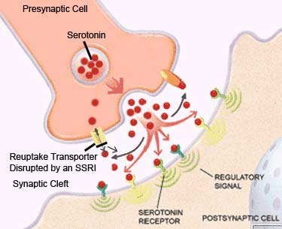
Treatments

Slide 16
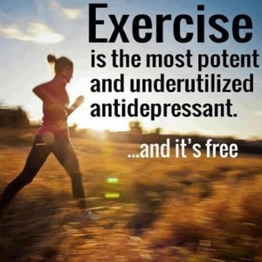
Treatments
Natural Treatments
Physical Exercise – increases levels of endorphins, which interact with receptors in the brain reducing perception of pain and triggering a positive feeling in the body
Exercise alleviates stress, boosts self-esteem, improves sleep and decreases feelings associated with depression
http://familyguidanceandtherapy.com/2013/08/dealing-with-depression-through-exercise/

Slide 17
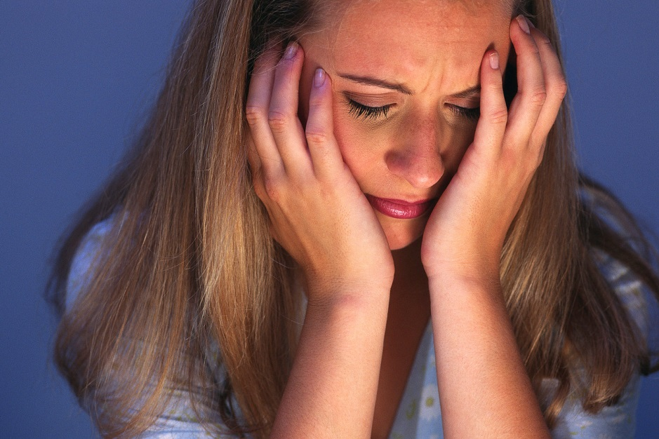
Major Depression
Major depression is a mental disorder characterized by a persistent feeling sadness, low self-esteem, and loss of interest.
Physical symptoms include: pain, headaches, skeletal, mood symptoms, and cognitive changes
In Canada, 5% of male youth and 12% of female youth

Slide 18
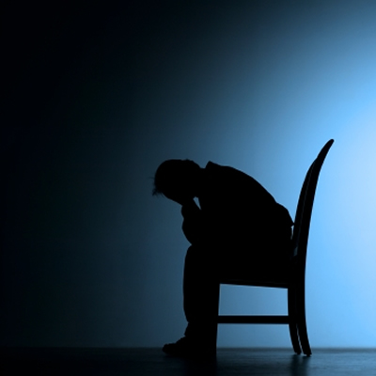
Major Depression
To be diagnosed with major depression, five or more of the following symptoms must be present for at least two weeks:
persistent depressed mood
diminished interest in almost all activities
diminished interest in all activities
significant appetite changes - weight gain or loss
insomnia nearly every day, fatigue
feelings of worthless
These symptoms cause significant distress or impairment in social, occupational, or other areas in life.
http://thecuriousdentist.com/depression-and-dentistry/

Slide 19

Major Depression
How to cope with major depression
behavioural intervention (self-care)
diet
sleep
exercise
therapy
What are the factors?
prior depressive episode
family history
gender
age
stressful life events
poor social events
http://hsmwestgate.org/2012/05/21/youth-depression/

Slide 20
Atypical Depression
Despite its name, atypical depression is a very common subtype of depression.
This subtype’s onset is usually during childhood and adolescence.
According to the DSM-V, indicators of atypical depression include:
A) Mood Reactivity
B) Two or more of the following:
weight gain or increase in appetite
hypersomnia
leaden paralysis
a long-standing pattern of interpersonal rejection sensitivity that results in significant social or occupational impairment.
C) Criteria are not met ‘with melancholic features’ or ‘with catatonia’ during the same episode
Treatments include medication and cognitive behavioural therapy.

Slide 21
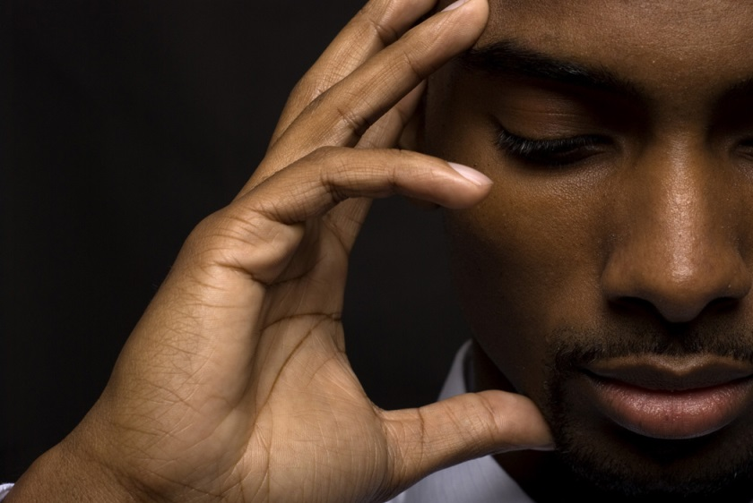
Seasonal Affective Disorder
When an individual experiences periods of major depression that occur during a particular time during the year, they may be diagnosed with seasonal affective disorder (SAD)
Other symptoms include:
weight gain
overeating
carbohydrate craving
loss of energy
oversleeping
daytime fatigue
There is a higher risk for SAD among younger people
Light therapy is considered the first-line treatment intervention. In order for maximum effect to be achieved, light intensity, light duration and time of day of exposure need to be individualized.

Slide 22
Persistent depressive disorder (dysthymia)
Symptoms are similar to but less severe than major depression. However, the symptoms of persistent depressive disorder last longer.
Core characteristic of persistent depressive disorder is experiencing a depressed mood that occurs for most of the day, for more days than not, for at least two years in adults, or at least one year for children and adolescents
Since this condition often develops during childhood and adolescence, most people postpone seeking treatment because they believe it is normal to constantly feel depressed

Slide 23

Postpartum Depression
A subcategory of major depression.
Symptoms are much like those of major depression, with the addition of thoughts of harming your baby.
Indicators and risk factors include:
pregnancy at a young age
unplanned pregnancy
earlier consideration of
terminating the pregnancy
lack of support
Affects 10-15% of new mothers
http://www.themonastery.org/blog/2012/03/going-to-church-may-not-reduce-depression-after-all/

Slide 24
Statistics
Depression:
3 Million Canadians
Less than 1/3 seek help
Higher in Females– 2:1
By 2020, WHO predicts that depression will be the second leading cause of disability to heart disease worldwide
Adolescents:
11% have a depressive disorder by age 18
Risk increases as age increases
Relapse:
50-60% relapse within a year of the first episode
80-90% can be treated successfully
Anxiety Disorders:
Not the same as depression
½ of people diagnosed with depression are also diagnosed with an anxiety disorder and vice versa

Slide 25

Suicide
People will depressive disorders carry out 80% of suicides
Women make 3-4 more suicide attempts than men, however men complete suicide more often
Generally, males attempt suicide earlier in a depressive episode than women
People aged 18-24 have the highest rate of mental disorders, including depression, of any age group
Suicide is the leading cause of death for people ages 15-24
http://rebloggy.com/post/depression-suicide-my-pictures/20468312933

Slide 26
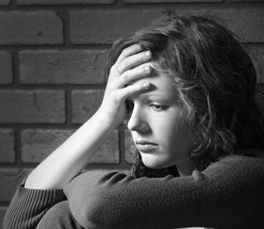
Case Study
For the last few months, Stephanie has been feeling really down. She does not want to go to school, and when she does she often falls asleep. She is so tired all of the time. When her friends try to talk to her, she often lashes out and walks away from them. She has been sarcastic and rude to her teachers, and her grades have been continuously declining. Her parents try to talk to her, but she never listens. She does not want to eat, shower, or do anything besides lie on her bed, alone. Stephanie’s mother decides to take her to their doctor, and Stephanie is diagnosed with depression.
What would you do as a teacher to help Stephanie with her depression in your classroom?
http://paradigmmalibu.com/common-feelings-precede-teen-drug-use/

Slide 27

Implications for Teachers
There are several strategies that teachers can follow to help students with depression.
Some suggestions include:
Developing a positive relationship
Using positive approaches
Remembering that students are not choosing to be depressed
Providing opportunities for success

Slide 28
Mindfulness
Mindfulness is about paying attention in a particular way: on purpose, in the present moment, and non-judgmentally.
Mindfulness can help by:
helping deal with stress, anxiety and depression
increasing compassion, empathy, and forgiveness
It is becoming more practiced in school systems.
Edmonton and Vancouver school districts now offer mindfulness training to all its teachers.

Slide 29
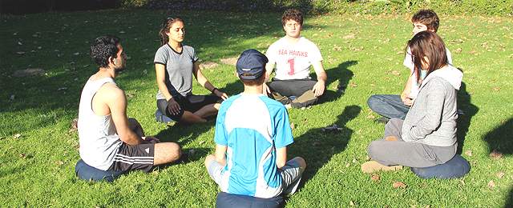
Mindfulness
The Mindful Way through Depression
Focuses on getting well and staying well
Teaches a different relationship to their sadness
8 week Mindfulness training program
Research has proven that in comparison to anti-depressants it is equally as important in treating depression.

Slide 30
Resources
Several resources available in Canada.
Some of these include:
the Mental Health Commission of Canada
Mind Your Mind
DepressionHurts.ca
Newfoundland and Labrador Mental Health Crisis Line
(709) 777 - 3200
the Canadian Mental Health Association
It is important for adolescents to be aware of
these services and to encourage them to avail of
these services if needed.
There are also:
Guidance Counselors
Psychologists
Psychiatrists
Social workers
Teachers

Slide 31
Questions?
Comments?

